Slide 1










Dot Product
The dot product (Skalarproduct) of two vectors is the scalar , where is the angle between the two vectors.
Notes:
Needed or unused?

Slide 2


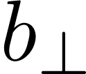
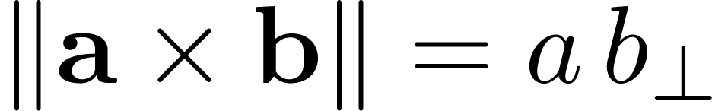
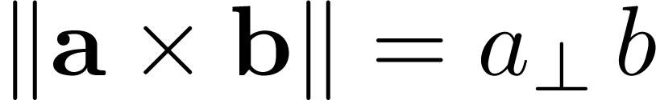
Cross Product

Slide 3
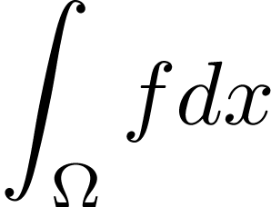
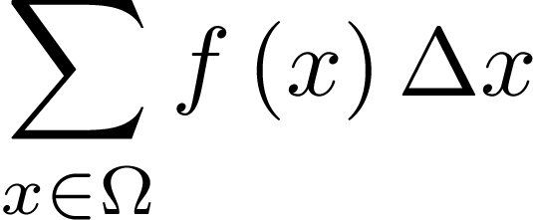
Calculus
Don’t be afraid of ‘complicated’ integrals like:
Just assume that we work on discrete functions and treat them as a sum (which they are):

Slide 4
Branches of Mechanics
There are three branches of mechanics that are of interest to us:
Definition
Kinematics (Kinematik) describes the motion of objects without regard for the reason of their movement.
(from Wikipedia)
Definition
Dynamics (Dynamik) or also called Kinetics (Kinetik) examines the correlation between an object‘s motion and the reasons for it.
(from Wikipedia)
Definition
Statics (Statik) analyzes the motion of objects without regard for the reason of their movement.
(from Wikipedia)

Slide 5

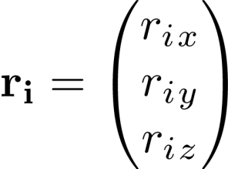

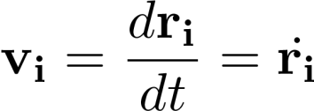


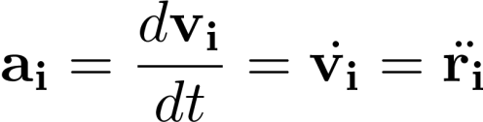
Linear Motion
Let’s look at the movement of a simple particle (Massenpunkt) . We identify a particle by its position .
The velocity of a particle is its change of position over time:
The speed (Tempo) of a particle is simply the magnitude of its velocity: . Likewise the acceleration is the change of velocity over time:

Slide 6
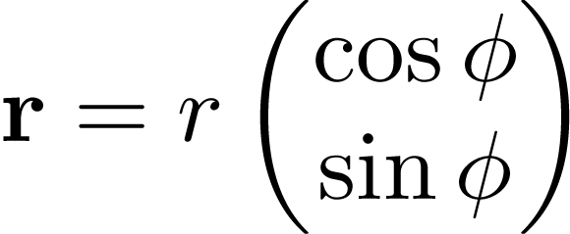


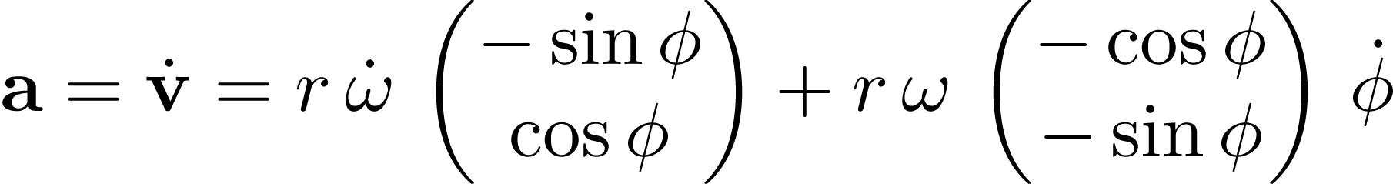


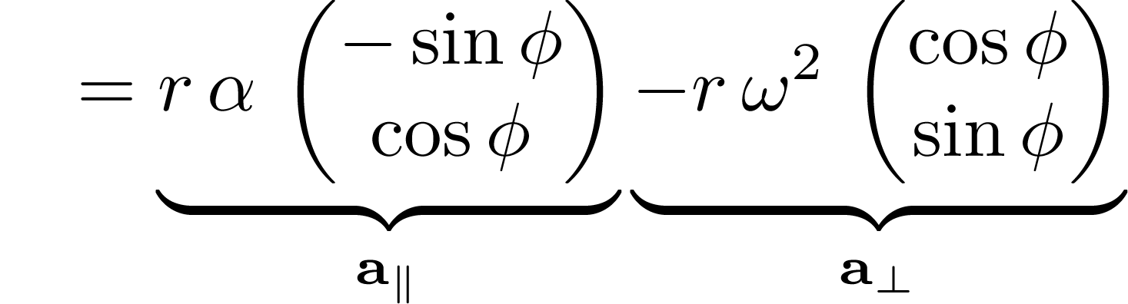

Example: Circular Movement
And because
Notes:
Speed and acceleration speed!

Slide 7


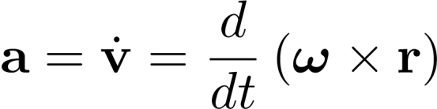

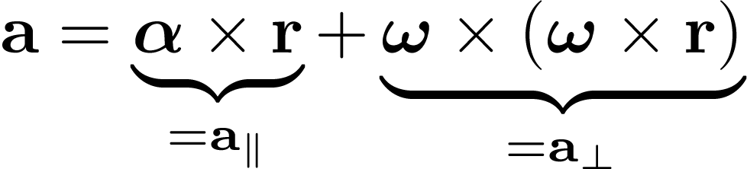
Example: Rotation around an Axis in 3D
So if we have:
What is the acceleration?

Slide 8




Angular Motion in 3D
It can be shown that (with a column-wise cross product).
Now we know how to get from to and can use the formulas that we have deduced when rotating a point around an axis:
and
to get convert from angular quantities to linear ones.

Slide 9





Summary
Linear Motion:
Position
Velocity
Acceleration
Angular Motion:
Orientation or
Angular Velocity
Angular Acceleration

Slide 10
Force
A force (Kraft) is any influence that causes a free body to undergo an acceleration.
A force has both magnitude and direction, making it a vector quantity.
(from Wikipedia)
It also has a point of action (Angriffspunkt): the point where the force is applied; and a line of action (Wirkungslinie): the line along the force’s direction through the point of action.

Slide 11
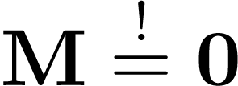

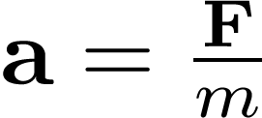

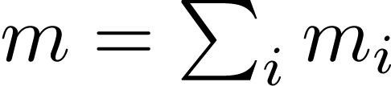
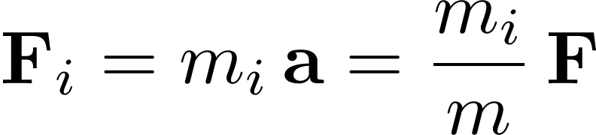
Center of Mass (Motivation)
What is a good choice for our point of reference?
It would be nice to choose it in such a way that applying a force to it won’t induce any actual moment on an unconstrained rigid body, that is .
This means that every particle as well as the whole rigid body will experience the same acceleration. So if a force is applied to the point of reference, the whole rigid body should be accelerated by . is the mass of the whole rigid body, ie . Then:

Slide 12
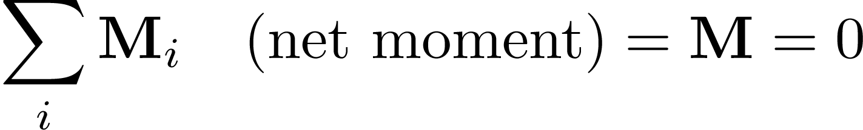
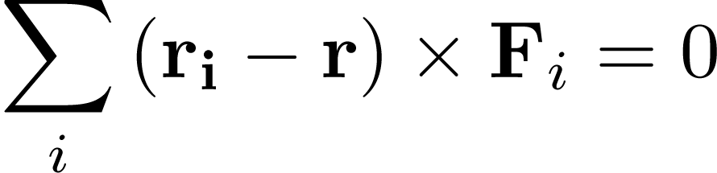
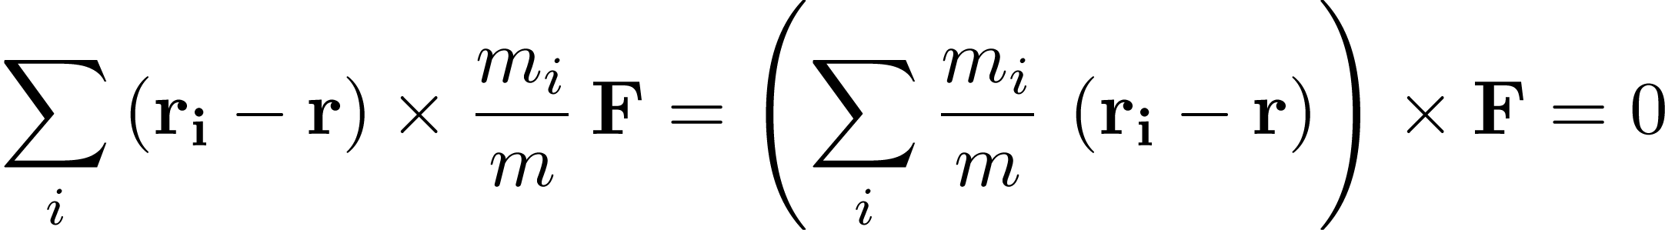
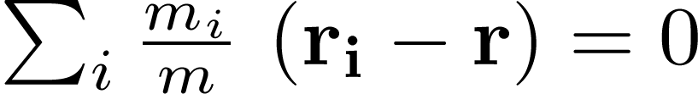
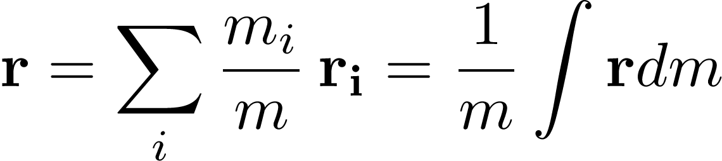
Center of Mass (Deduction)
Because the last statement has to hold for any force , it follows that , that is:

Slide 13
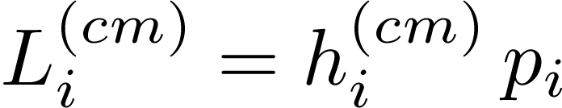
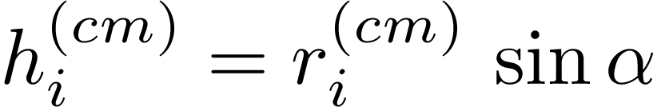
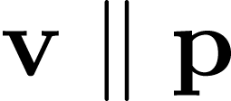


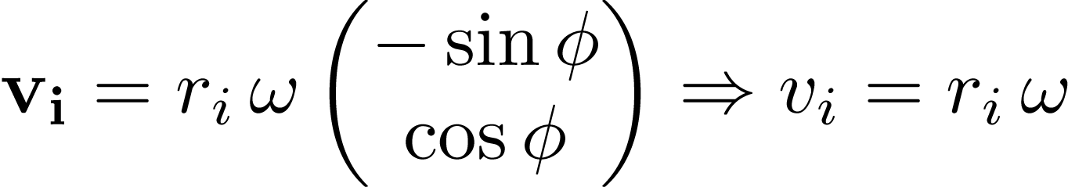
Inertia Tensor in 2D
In 2D the moment definition can be simplified to scalars (like we did for the moment):
with
If we look at an angular motion, it can also be thought of as circular motion around the center of gravity and since is collinear with , we know that it is perpendicular to , this gives . From the slide about circular movement we also know that
.

Slide 14
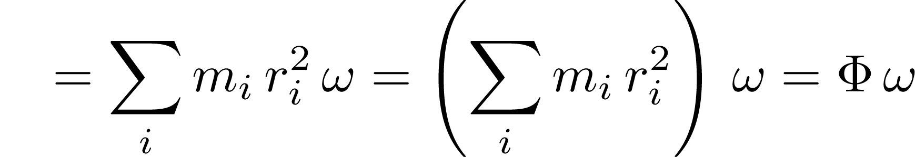
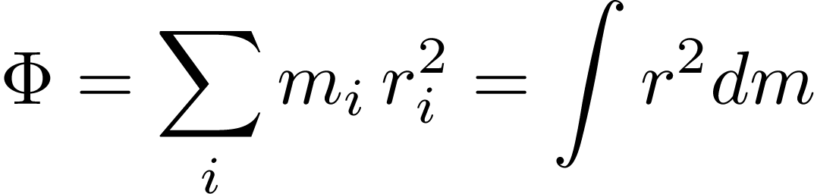
Inertia Tensor in 2D
with

Slide 15
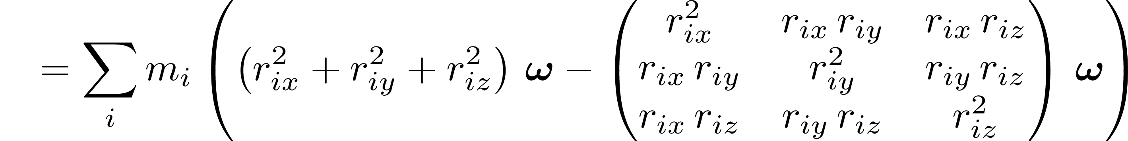
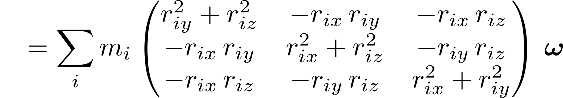
Inertia Tensor in 3D
We can do the same in 3D, but this we’ll get a 3x3 matrix. Here is an over-simplified deduction:

Slide 16
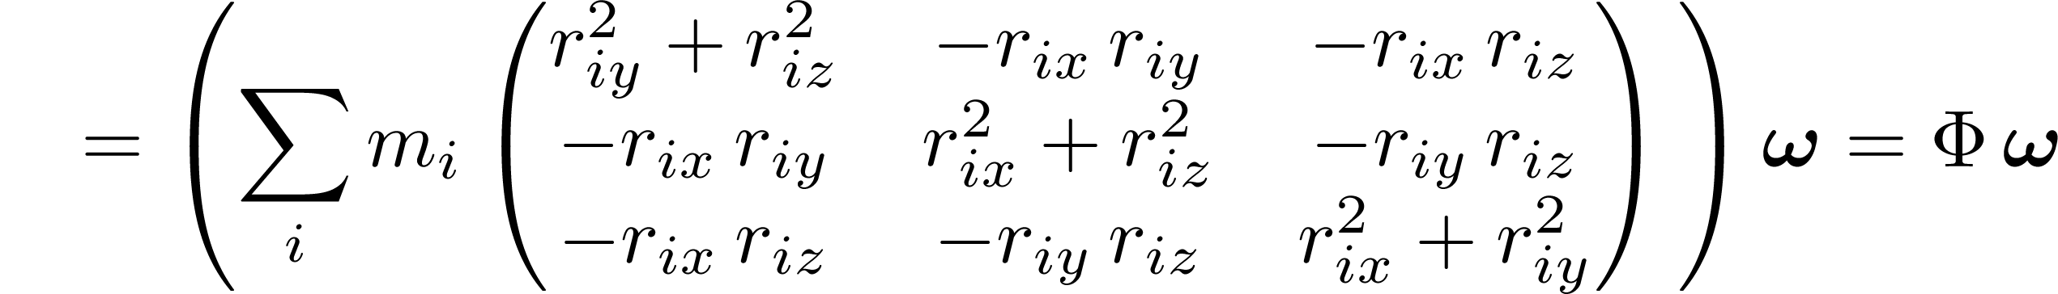
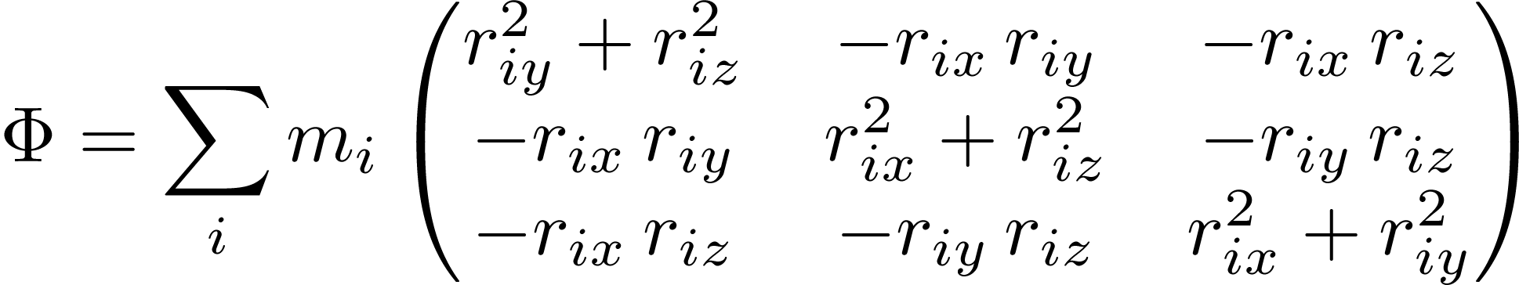
Inertia Tensor in 3D

Slide 17

Inertia Tensor in 3D
Definition
In 3D the inertia tensor is a matrix:
The deduction is similar to the 2D case, only more heavy-handed.

Slide 18

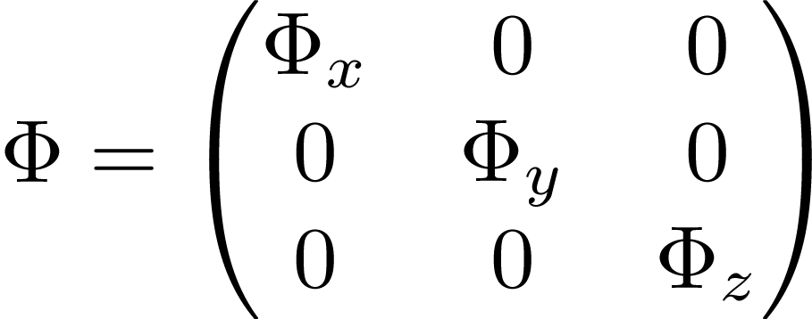
Intuition behind the Inertia Tensor
It is possible to rotate many objects in such a way that is diagonal.
The bigger the diagonal entry the more inert the object is regarding a rotation around that axis.
The smaller is in total, the faster the object’s rotation axis can change.

